Slide 1
The Zen of Coding
The Coding Bootcamp

Slide 2

Quick Introductions! (30 seconds)
Name
Location
Background (Career, Education, Interests)
Why learn web development?
Excited about class?
Notes:
This class is, after all, about you – so let’s do some introductions.
(You may also want to ask “Fears about class?” – that can turn a little negative, so be ready to dissuade/make happy the students if you do ask this)

Slide 3

Instructor = … ?
Tanetta Jordan
Bachelors (Information Systems Technology Masters (Business Administration) Cleveland State University
Sr. Web Developer Cleveland Metroparks
Over 15 years coding, (with plenty of experience being a n00b at it.)
Once attended a school to become a certified mixologist
Secretly, want to be a disco dancer
Insert image here
Notes:
Enough about you, time to talk about me.

Slide 4
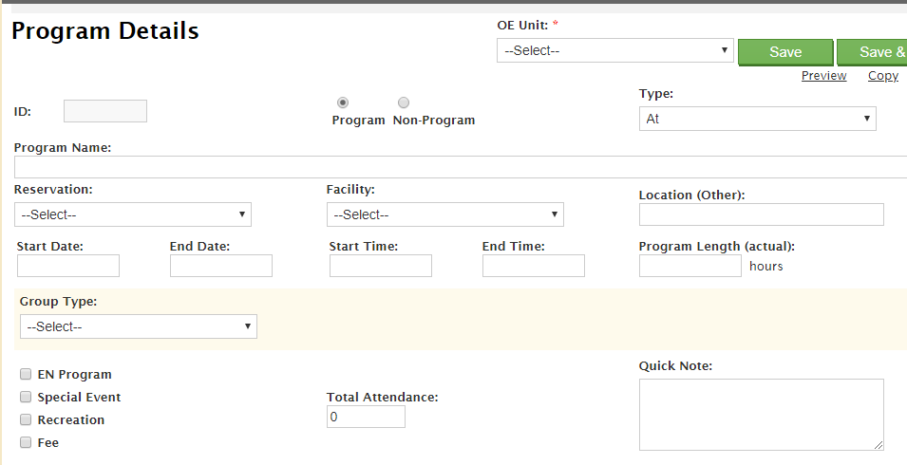
Some Cool Stuff I Made…
Notes:
Here’s this cool thing I built. It does X and it’s important because Y.
Questions?

Slide 5
The Path of Learning

Slide 6
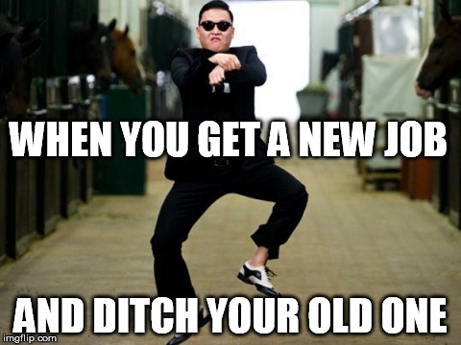
Your Goals...
New Career
Basically 1000% of you said…

Slide 7
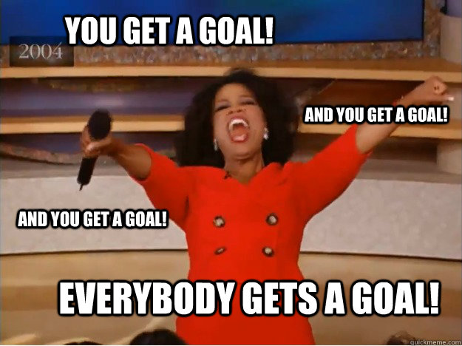
Your Goals...
And why do you want a new career?
To escape a “dead-end job”
To pursue a “dream”
To be able to “create”
To follow a “fascination”
To attain “financial stability”
To attain “financial freedom”
To “challenge” yourself
To be a “role model” for kids

Slide 8
Your Goal = Our Goal
As instructors,
we take your goals very, very seriously.

Slide 9
Support Team
Our Promise:
If you’re willing to put in the time – and you take our advice, we’re here to help you 100% of the way.
This goes for everyone working behind the program:
Instructors
TAs
Student Success Team
Career Coaches
Everyone Else!
Notes:
This program will not be a traditional college class. We're here to support you 100% of the way to really help you achieve their goals.

Slide 10
But Remember…
Nothing good comes easy.
Notes:
There are a few things you can do to ensure your success

Slide 11
On Keys To Success…

Slide 12

Don’t Be This Guy…
Notes:
First off, don’t be this guy.
Those that have the hardest time in the program are not the ones who came in knowing no programming.
It’s not the ones who haven’t played around with HTML, CSS, or Javascript.
It’s the ones who walk in thinking they either A) Know more than they do. Or B) Are experts in a completely different field.
There is something that stops people like this from accepting the reality.

Slide 13
This Should Be You.
You
Notes:
Having a humble attitude is the first requirement of being successful in this program.
You are a blank slate. Seriously. Don’t lose sight of this image. At first it may feel intimidating. Knowing how little you know. But relish the opportunity and take the privileges it comes with.
You have permission to struggle. To fail. To not “get” everything immediately.

Slide 14
Our Mantra for Today and Beyond…
When it comes to web development…

Slide 15
Our Mantra for Today and Beyond…
I know nothing.
Notes:
Don’t be frustrated! Keep an open mind – you’re here to learn.
You mastery of other subjects, educational backgrounds, and professional successes do not guarantee that you will do well here. The only thing that will guarantee success is hard work, humility, and a relentless desire to be better.

Slide 16
The Path of Learning
Notes:
So how does one learn? Well…

Slide 17
Nothing Comes Easy…
As students, you face three
HUGE obstacles!
Notes:
… there are a few obstacles in the way.
Things that will frustrate you…

Slide 18
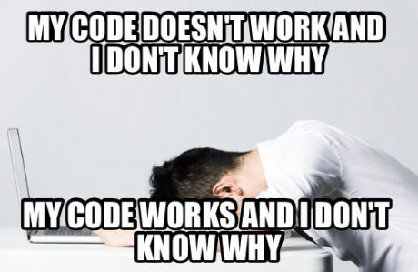
Obstacle #1 – The Great Confusion
Notes:
Obstacle 1 First, learning to code is tough, intimidating, and frustrating at times. You should forget about your uncle/brother-in-law/friend/step-sister who told you about so-and-so learning to build apps in 1 week. Coding is hard. It will take time. There is no way around that.
It’s confusing, difficult, and there’s a ton to learn. But it’s super rewarding when you _do_ learn why your code broke or is working.

Slide 19
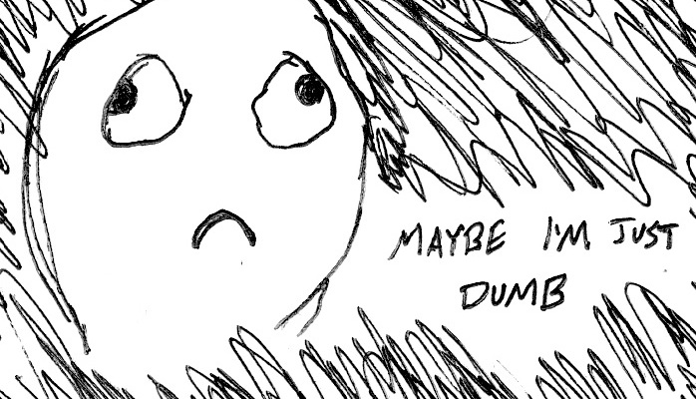
Obstacle #2 – The Great Doubt
Notes:
Obstacle 2
There will be many moments where you will doubt yourself.
Everyone is on the same page as you. No-one in this classroom is dumb. You all have varying backgrounds with differing experiences and exposure.
Everyone was where you are at some point in their career. Every single developer. Me too.
It takes time but you have what it takes; you were selected for this program because we know you have what it takes.
The first few weeks will be difficult, but everyone will be on a pretty level playing field a few weeks in.

Slide 20

Obstacle #3 – The Great Distance
Notes:
Obstacle 2 – you have a ton of ground to cover!
There’s a lot to learn, and it can be intimidating. But honestly, 6 months will be over before you know it.
Because of the length of the program, personal issues WILL come up during the course of the program, and it will be challenging to stay motivated.
You should see each other as a family embarking on a long journey. You will become far closer to your peers than you realize. Intensity is no substitute for endurance.

Slide 21
Nothing Comes Easy…
Learning to Code Requires Two Things:
Persisting in the face of something that feels incredibly hard and confusing.
Maintaining the self-confidence necessary to believe that you CAN DO THIS.
Notes:
And will take a while to master. Persisting in general is the #1 hardest thing in this course.
Perhaps tied with having self-confidence (talk about imposter syndrome).
Everyone stand up and say… “I can do this!”

Slide 22
Learning is “Frustrating”
“You can’t tell whether you’re learning something when you’re learning it—in fact, learning feels a lot more like frustration.”
“What I’ve learned is that during this period of frustration is actually when people improve the most, and their improvements are usually obvious to an outsider. If you feel frustrated while trying to understand new concepts, try to remember that it might not feel like it, but you’re probably rapidly expanding your knowledge.”
Jeff Dickey, Author of Write Modern Web Apps with the MEAN Stack: Mongo, Express, AngularJS, and Node.JS
Notes:
Frustration = learning, seriously. Here’s the author of a pretty famous book on the mean stack:
So how do we get through this frustration and actually learn?

Slide 23
Advice for the Journey
Throughout this course, always remember to:
Work Hard!!

Slide 24

Advice for the Journey
Throughout this course, always remember to:
Work Hard!!
Appreciate your successes

Slide 25

Advice for the Journey
Throughout this course, always remember to:
Work Hard!!
Appreciate your successes
Trust yourself
Notes:
Questions?

Slide 26
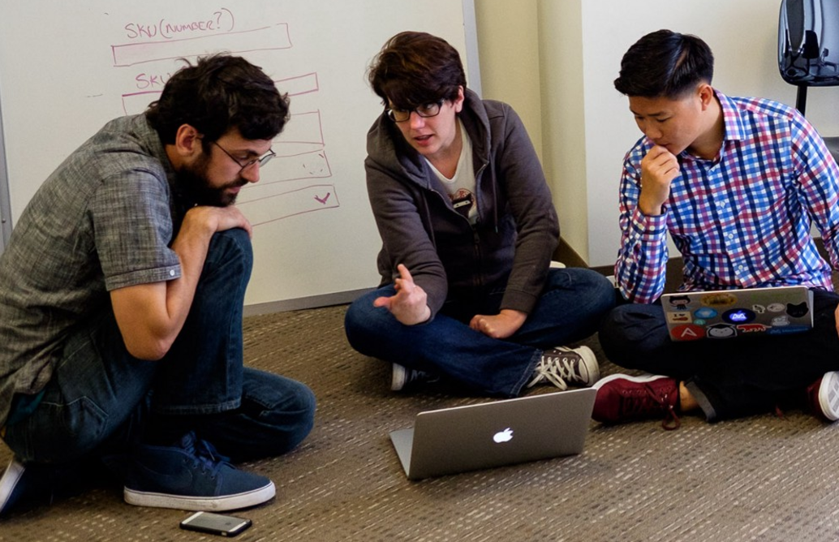
But remember…
If you want to go fast, go alone.
If you want to go far, go in a team.

Slide 27

Google Fu – The Most Important Skill of All
What is Google Fu?
Notes:
Of course, to do this, you’ll need to be great at googling!
This is arguably the best/most important skill you can use.
It’s silly, but being able to find the answers to your questions is extremely important, and people won’t always be around. Google should almost always be your first go-to (it has almost every answer, if you know how to find it).

Slide 28
Course Structure
Notes:
Now that we’ve talked about the journey and how to be successful, let’s talk about the stops along the way.

Slide 29
Daily Schedule
For each class we’ll run through the following:
Set Objectives
Brief Background Lecture
Watch Me / Coding Demos
Code Discussions
In-Class Exercises
Project Work
The Super Important Stuff!!!
i.e. Always be coding!
Notes:
By coding! Unfortunate, right?
We’ll get a ton of in-class practice reading and writing code, so the course quickly becomes “code-centric”.
Most days will be much less presentation-heavy than today.
Questions?

Slide 30

Questions?

Slide 31
Pre-Work
Notes:
So next up I want to spend a little bit of time checking that everyone has everything they need installed (from the pre-work).
If you can check off all of these things, spend this time helping your neighbors. This should become a habit – try to ask for help form your neighbors before going to a TA (you will both learn more along the way). < We’ll talk more about this soon.
That said, let’s check some things off of a list.

Slide 32
Software Checklist
At this point, you should have each of these installed:
Slack
Visual Studio Code
Git for Version Control
Git Bash (Windows) or Terminal (Mac)
Node.js
Heroku-CLI
Google Chrome

Slide 33
Accounts Checklist
You should also now have accounts for:
GitHub (with SSH Integration)
Heroku
LinkedIn
Stack Overflow
Notes:
LinkedIn and Stack Overflow… get involved!

Slide 34
Self-Check
Let’s do some quick checks of the following:
Visual Studio Code Check
Git Bash / Terminal Check
Node Check
Git Check
Heroku Check

Slide 35

Break…

Slide 36
On the Modern Web

Slide 37

Full-Stack Development?
Notes:
So what exactly does it mean to be a “full stack developer?”
Call out 2 people and ask this question

Slide 38
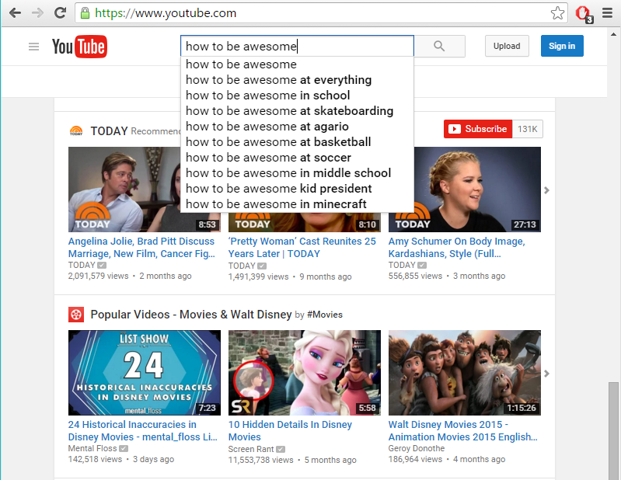
The “Magic” of YouTube
Notes:
Let’s use YouTube as an example. (Go to YouTube and do basic search)
You’ll learn all of this in time, but a basic YouTube search requires two things:
A ”frontend” – the graphical user interface which responds to what I type
A “backend” – the code on the “server side” that is able to do the logic behind the search, find the relevant videos, and send them along
Call on someone to explain what they think each are

Slide 39
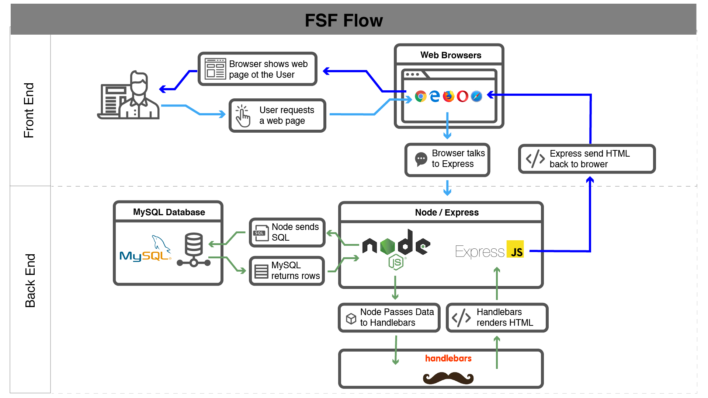
Full-Stack Development
In modern web apps, there’s a constant back-and-forth communication between two key components: the visuals displayed on the user’s browser (frontend) and the data and logic stored on the server (backend).
Notes:
Websites today are all about reading code for these components – “frontend” and “backend”

Slide 40
Full-Stack Development
Full-Stack Development is the concept of building every aspect of the web application – from the visuals and interactions, to the data transfer and processing.
Notes:
That is “Full-Stack Development” – you build can and will build the whole thing.

Slide 41
Full-Stack Development
The Browser
Dev Tools
Server Side
HTML
CSS
JavaScript
jQuery
Bootstrap
SEO
Heroku
Git
GitHub
Templating Engines
Sessions
Writing tests
Node.js
Express.js
Creating APIs
MVC
User Authentication
ORM (Sequelize)
Databases
MySQL
MongoDB
API Interaction
APIs (Consuming)
JSON
AJAX
Real Time Cloud Database via Firebase
Algorithms
Design Patterns
CS Fundamentals
Cutting Edge Development
React.js
Notes:
In this course, you’ll learn everything you need to be able to do this –
you’ll be able to build complex web applications even as a single developer.
Questions?

Slide 42
Let’s Get Crackin!

Slide 43
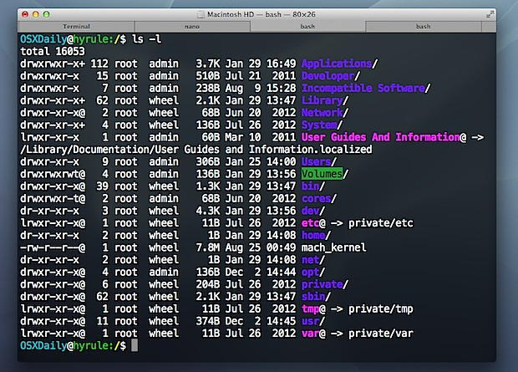
Intro to Console / Terminal
Notes:
The terminal is the portal to your computer – it allows you to run and even script commands that can create files, folders, and more.
It is extremely important that you get intimately familiar with the terminal as soon as possible, as you’ll use it for almost everything. It is fast and powerful.
NEXT

Slide 44


INSTRUCTOR DEMO…
Intro to Console / Bash
cd | change directory
cd ~ | change to home directory
cd .. | move up one directory
ls | list files in folder
pwd | show current directory (print working directory)
mkdir <FOLDERNAME> | create new directory
touch <FILENAME> | create a new file
rm <FILENAME> | delete file
rm –r <FOLDERNAME> | delete folder
open . | open the current folder (MAC)
open <FILENAME> | open a specific file (MAC)
explorer . | open the current folder (BASH)
explorer <FILENAME> | open a specific file (BASH)
directory ~ folder
file ~ document
Notes:
Your turn!

Slide 45
ALL TOGETHER ;)
Activity: Get Situated | Suggested Time: 1 min
Assignment:
Make a folder on your desktop named code.
Put all of your code that you do inside of that folder.
Best Practices:
Always use lowercase for folder and file names.
Never put in spaces in your folder and file names.
Use dashes to separate.
Notes:
Your turn!

Slide 46
YOUR TURN!
Activity: Console Commands | Suggested Time: 12 min
Assignment:
From the Terminal / Console and using only the command line, create:
A new folder with the name of first_day_stuff.
A new HTML file with the name of first_day.html.
Open the current folder containing the new HTML file.
Bonus:
Create multiple directories/folders with the names one_folder and second_folder in one command.
Create multiple files with the names one.html and two.html in one command in the first_day_stuff directory.

Slide 47

Intro to Console
Discuss with Neighbors
What else would I like to know?
The process of creating files
Removing files
Notes:
Re-ask the questions after a couple of minutes walking neighbor-discussion:
How do you create a new folder?
How do you create a new file?

Slide 48
Hello, HTML
Notes:
Now that you can create HTML files from the terminal, let’s create one and actually write some HTML.

Slide 49

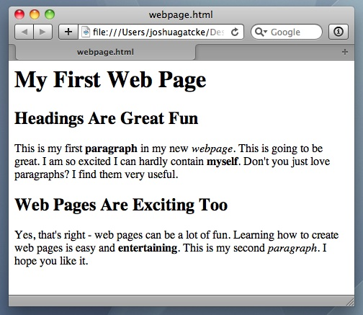
<title> Intro to HTML </title>
HTML is one of the three base languages behind every single website.
It defines all of the basic content and a bit of formatting.

Slide 50
HTML Basics - Overview
Tags
HTML uses tags to identify page content
<h1> - heading 1
<p> - paragraph
<img> - image
<a href=“”> - link
<strong> - bold
<em> - italic
Elements
Refer to tags and their elements
Most elements have a open and close tag
Elements must be nested properly
Attributes
Attributes add function or meaning to elements

Slide 51
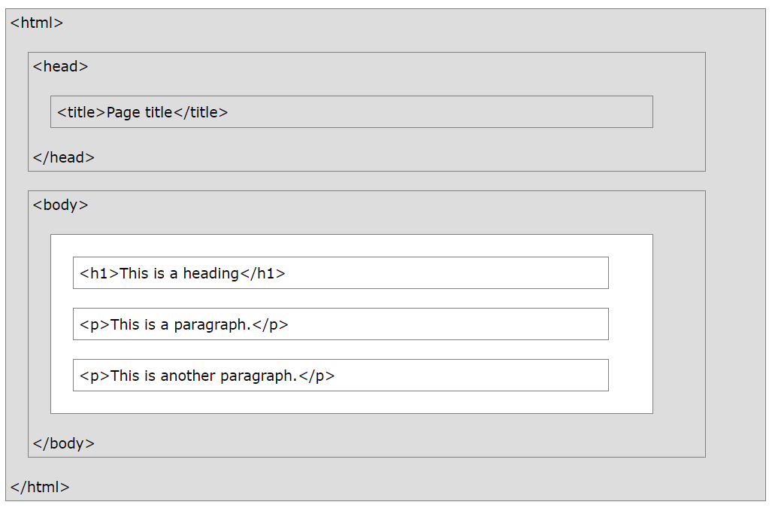
INSTRUCTOR DEMO…
Hello, HTML
<!DOCTYPE html>

Slide 52
YOUR TURN!
Activity: Intro to HTML | Suggested Time: 5 min
Assignment:
In a new HTML file, create the basic structure of an HTML document and include the following in it:
DOCTYPE declaration.
Head tag with a title tag.
H1 tag with a title of your choice.
Embed an image.
Create the following three links on your page:
One link that is target="_blank" so that it opens a new tab when clicked on.
Make the second link bold.
Make the third link a placeholder so it goes nowhere.
Bonus:
Create an ordered list of steps to make a sandwich.
Create an unordered list of 5 bands/musicians you like.
Create a table with 2 columns (animal class and animal name) and 4 rows of animals.
Use an alternate way of separating links without line breaks.
Embed a YouTube video of your favorite band/musician.

Slide 53
LET’S REVIEW
Activity: Intro to HTML
Assignment:
In a new HTML file, create the basic structure of an HTML document and include the following in it:
DOCTYPE declaration.
Head tag with a title tag.
H1 tag with a title of your choice.
Embed an image.
Create the following three links on your page:
One link that is target="_blank" so that it opens a new tab when clicked on.
Make the second link bold.
Make the third link a placeholder so it goes nowhere.
Bonus:
Create an ordered list of steps to make a sandwich.
Create an unordered list of 5 bands/musicians you like.
Create a table with 2 columns (animal class and animal name) and 4 rows of animals.
Use an alternate way of separating links without line breaks.
Embed a YouTube video of your favorite band/musician.

Slide 54

<title> Intro to HTML </title>
How’d it go?

Slide 55
Homework!

Slide 56
Supplemental Videos
Review the Supplemental Videos
Recap of some of the items we learned today
Includes additional HTML tags
Example Video
My First HTML https://www.youtube.com/watch?v=ieb6Svbc10E

Slide 57
Homework “Due”: Next Class
By Next Class:
Figure out where the GitHub Repo is for our class.
Re-do the Terminal example from class today.
Re-do the HTML example from class today.
Watch the Walkthrough Video if you felt a bit lost.

Slide 58
Questions?

